Slide 1
R-Programming
- Rahul Tiwari

Slide 2
Agenda
Installing a package / setting up working directory
Introduction to R
Data Handling in R(Data Type)

Slide 3
Setting up R and IDE’s (RStudio)
https://www.andrewheiss.com/blog/2012/04/17/install-r-rstudio-r-commander-windows-osx/

Slide 4
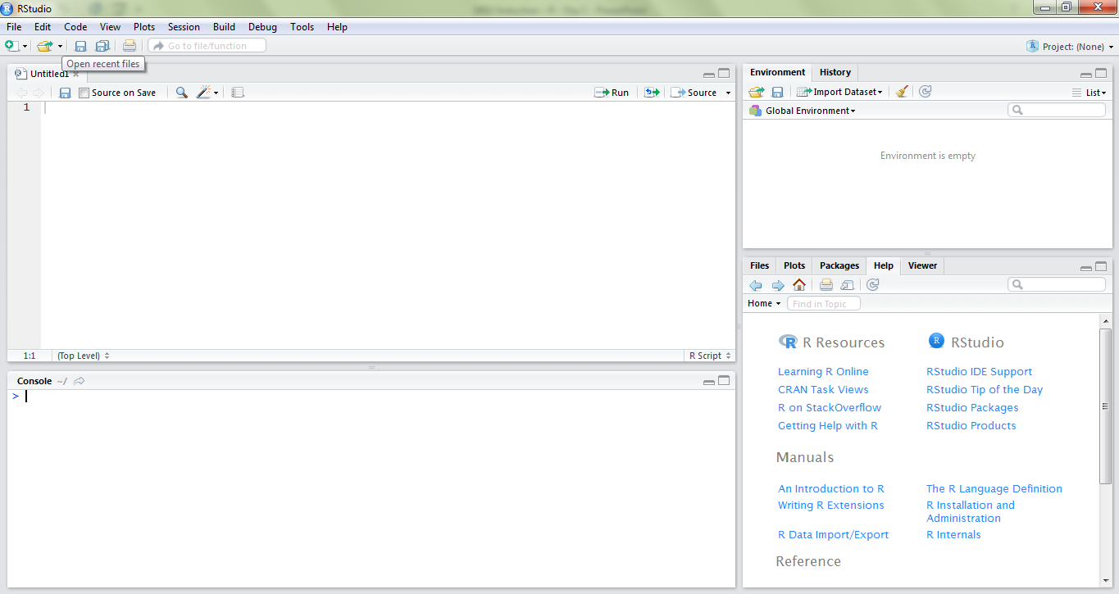
RStudio
Editor
Workspace
Console
Help and Plot

Slide 5
?

Slide 6
Introduction to R
R is a programming language and free software
It is used for statistical computing and graphical representation of data that you can use to clean, analyze, and graph your data
R is more Domain specific language
It also includes Machine Learning Algorithms
Scholar and R&D

Slide 7
Questions ?
1. Should I learn R or Python first?
In the context of data science, learn Python first, then learn enough R to be able to get your analysis done, unless the lab that you're in is R-dependent, in which case learn R and fill in the gaps with enough Python for easier scripting purposes
2. Is R better than Python?
Since R was built as a statistical language, it suits to do statistical learning.
Python, on the other hand, is a better choice for machine learning with its flexibility for production use, especially when the data analysis tasks need to be integrated with web applications.
R is mainly used for statistical analysis while Python provides a more general approach to data science

Slide 8
PYTHON
Python can be used in various domains like Web application, IoT, ML, DL, etc. and can be integrated very easily with other platforms.
R
Whereas R is a domain specific, which means it is better than any other programming language when it comes to statistics and plotting.

Slide 9
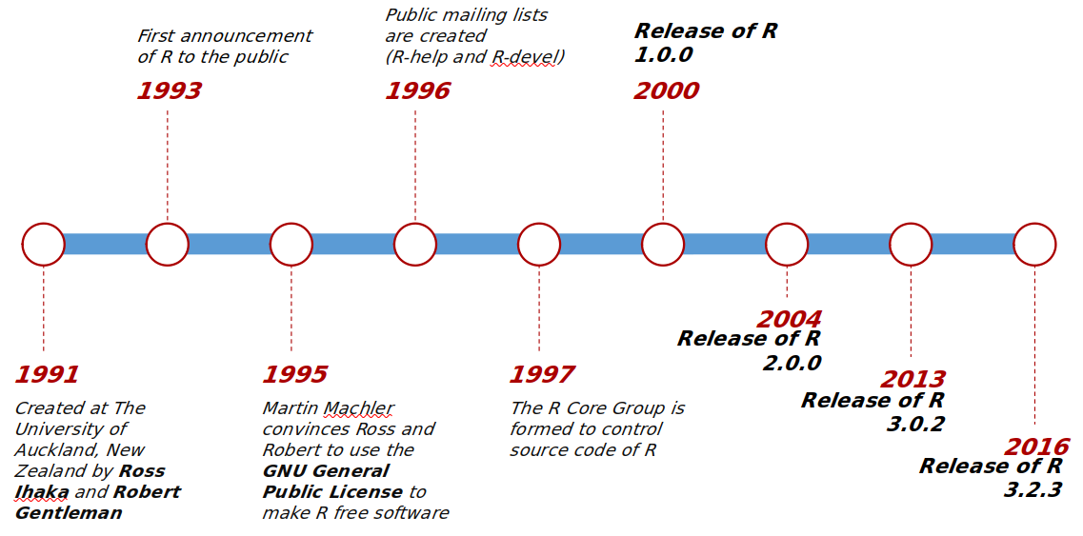
History of R
This programming language was named R, based on the first letter of first name of the two R authors Robert Gentleman and Ross Ihaka.
Python - 1990
R - 1993
Java - 1995

Slide 10
Data Handling in R
R Atomic Data Types
R Data Objects
Data Type | Example
Logical | TRUE/FALSE, 1/0
Integer | 12L, 9L
Numeric | 1.2, 200, 54
Character | “a”, “Hello”, “TRUE”, “23.4”
Data Objects | Dimensions | Notes
Vector | 1 dimensional | All elements must have the same data type
Matrix | 2 dimensional
Data Frame | 2 dimensional | Each column can have different data type
Factor | 1 dimensional | Stores vectors along with the distinct values of elements as labels
List | Multi-dimensional | Combination of different data types and data objects
Converting data types – as.numeric(), as.character()…
Checking data types – is.numeric(), mode(), typeof(), class()

Slide 11
Difference between 'NUMERIC' and INTEGER Data types in R
There are multiple classes that are grouped together as "numeric" classes,
the 2 most common of which are double (for double precision floating point numbers)
and integer. R will automatically convert between the numeric classes when needed,
so for the most part it does not matter to the casual user whether the number 3 is
currently stored as an integer or as a double. Most math is done using double precision,
so that is often the default storage.
Sometimes you may want to specifically store a vector as integers if you know that they
will never be converted to doubles (used as ID values or indexing) since integers require
less storage space. But if they are going to be used in any math that will convert them
to double, then it will probably be quickest to just store them as doubles to begin with.

Slide 12
Datatypes in R
1. Vectors¶
When you want to create vector with more than one element, you should use c() function which means to combine the elements into a vector.
It is 1 Dimensional
All elements must have the same data type.
Example
# Create a vector.
apple <- c('red','green',"yellow")
print(apple)
# Get the class of the vector.
print(class(apple))

Slide 13
# Create a vector.
num1 <- c(10L,20L)
print(num1)
# Get the class of the vector.
print(class(num1))

Slide 14
2. LISTS
A list is an R-object which can contain many different types of elements inside it like vectors, functions and even another list inside it.
It is Multi-Dimensional
Lists are the R objects which contain elements of different types like − numbers, strings, vectors and another list inside it. A list can also contain a matrix or a function as its elements. List is created using list() function.
- Example
# Create a list.
list1 <- list(c(2,5,3),21.3, 12L)
# Print the list.
print(list1)

Slide 15
3. MATRICES
A matrix is a two-dimensional rectangular data set.
It can be created using a vector input to the matrix function.
- Example
M = matrix(c('a','a','b','c','b','a'))
print(M)
M = matrix(c('a','a','b','c','b','a'), nrow = 2, ncol = 3)
print(M)
# nrow - means number of required rows
# ncol - means number of required columns

Slide 16
# Create a matrix.
M = matrix( c('a','a','b','c','b','a'), nrow = 2, ncol = 3, byrow = TRUE)
print(M)
# byrow - means it will add elements in row, by default it adds elements by columns

Slide 17
4. FACTORS
Factor in R is a variable used to categorize and store the data, having a limited number of different values.
Factor in R is also known as a categorical variable that stores both string and integer data values as levels.
Factor is mostly used in Statistical Modeling and exploratory data analysis with R.
Factors are the r-objects which are created using a vector. It stores the vector along with the distinct values of the elements in the vector as labels. The labels are always character irrespective of whether it is numeric or character or Boolean etc. in the input vector. They are useful in statistical modeling.
Factors are created using the factor() function. The nlevels functions gives the count of levels.

Slide 18
- Example
# Create a vector.
apple_colors <- c('green','green','yellow','red','red','red','green')
# Create a factor object.
factor_apple <- factor(apple_colors)
# Print the factor.
print(factor_apple)
print(nlevels(factor_apple))
Output:
[1] green green yellow red red red green
Levels: green red yellow
[1] 3

Slide 19
# Create a vector as input.
data <- c("East","West","East","North","North","East","West","West","West","East","North")
print(data)
print(is.factor(data))
# Apply the factor function.
factor_data <- factor(data)
print(factor_data)
print(is.factor(factor_data))
Output:
[1] "East" "West" "East" "North" "North" "East" "West" "West" "West" "East" "North"
[1] FALSE
[1] East West East North North East West West West East North
Levels: East North West
[1] TRUE

Slide 20
Type casting
as.numeric()
as.character()
as.integer()
as.vector()
as.matrix()
as.factor()
- Example
x = 12L
print(class(x))
y = as.numeric(x)
print(class(y))
x = 12
print(class(x))
y = as.integer(x)
print(class(y))
print(y)

Slide 21
Datatype validations
is.numeric()
is.character()
is.integer()
is.vector()
is.matrix()
is.factor()
# It will return whether true or false
- Ex:
var1 = 10.2
is.numeric(var1)
data = 'rahul'
is.integer(data)
is.character(data)

